Slide 1


LAGIER Raphaël
22/10/2023

Slide 2

Outline
Executive Summary
Introduction
Methodology
Results
Conclusion
Appendix

Slide 3
Executive Summary
We were asked to predict the rate of successful landing of SpaceX Falcon 9 . Therefore, we analyzed the impact of several variable on the results such as Payload Mass, Launch site, Date, Booster Version…
To achieve our goal, we used Python and its libraries for :
Data collection
Data wrangling and formatting
Data visualization
Machine Learning prediction
All our analyses an researches lead to a prediction of succefull landing rate of 83.33%.

Slide 4
Table of Contents
Summary of methodologies
- Executive Summary
- Data Collection
API
Web Scrapping
- Data Wrangling
- Data Visualization
- SQL
- Plotly Dash
- Machine learning

Slide 5
Table of Contents
Summary of all results
- Graphic EDA
- Proximities analysis
- Dashboard
- Predictive Analysis

Slide 6
Introduction
In this capstone, we will predict if the Falcon 9 first stage will land successfully. SpaceX advertises Falcon 9 rocket launches on its website, with a cost of 62 million dollars; other providers cost upward of 165 million dollars each, much of the savings is because SpaceX can reuse the first stage. Therefore if we can determine if the first stage will land, we can determine the cost of a launch. This information can be used if an alternate company wants to bid against SpaceX for a rocket launch. In this module, you will be provided with an overview of the problem and the tools you need to complete the course.

Slide 7

Section 1

Slide 8
Methodology
Executive Summary
Data collection methodology:
Space X API (using requests)
Web Scrapping (using requests & BeautifulSoup)
Perform data wrangling (with pandas & numpy)
Work on values quality : Identify missing values and type of values
Analyze value: number of launch per site, per orbit, successful launch per orbit

Slide 9
Methodology
Executive Summary
Perform exploratory data analysis (EDA) using visualization and SQL
Perform interactive visual analytics using Folium and Plotly Dash
Perform predictive analysis using classification models
Standardize data with StandardScaler
Split data for training (80%) and testing(20%)
Set and evaluate 4 classification methods : SVM, Logistic regression, KNN, Decision tree
Using predict, confusion matrix, score.

Slide 10
Data Collection
Data were collected by 2 ways:
Using requests on SPACE X API Space X api link
Using requests and BeautifulSoup (BS) on Wikipedia site. Wikipedia Link
Web scraping with BeautifulSoup
API Data collection with Request
Extracting Data
Connecting with request
Extraction with BS
Recording
Create data Frame
Saving Dataframe
Extracting Data
Connecting with request
Extraction with request
Recording
Create data Frame
Saving Dataframe
Using Json Normalize

Slide 11
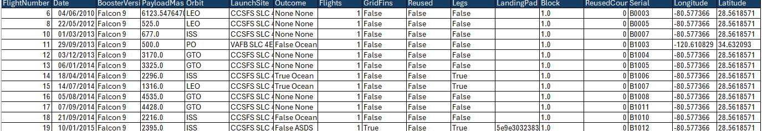
Data Collection – SpaceX API
Create a connection to Space X API to withdraw data required to perform a data analyse.
The Data Frame contains 17 features and 90 records after removing Falcon 1 launch.
We decide to keep empty Landing pad with 26 null values to count launch with no landing.
We replaced 5 missing value for payload mass with the means of payload mass recorded.
Ghithub link to Api Collection Notebook
Create functions
Create get request
Normalize data
Create a dataframe with pertinent data

Slide 12
Data Collection - Scraping
Create a request to https://en.wikipedia.org/wiki/List_of_Falcon_9_and_Falcon_Heavy_launches
The Data Frame contains 11 features and 121 records.
The data Booster Version is not very relevant due to the lack of 116 records.
GitHub Webscraping notebook
Create functions
Create get request
Extr act the data from URL with BeautifSoup
Create a dataframe with pertinent data

Slide 13
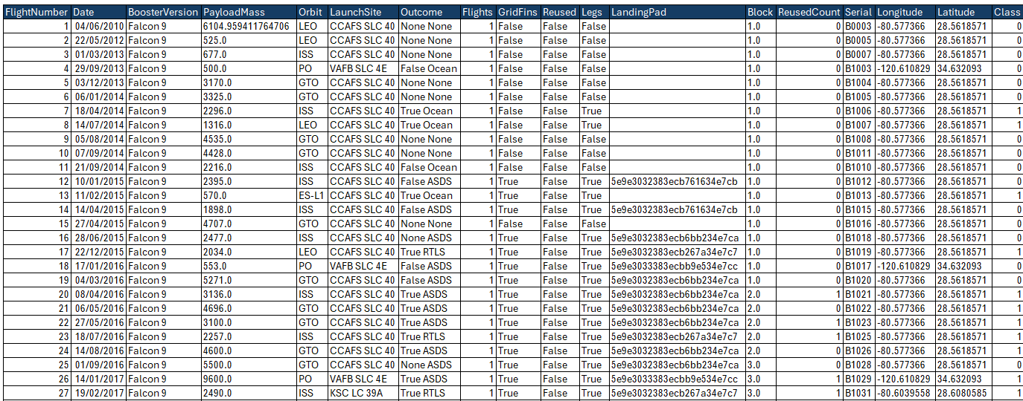
Data Wrangling
We analyze the data to determine the number of launch per orbit and the successful landing rate
We had to affect O or 1 to bad and successful landing to calculate the average.
66,6% of landing were succeeded
GitHub Data Wrangling notebook
Calculated the % of messing value for each attribute
Control the data type of each attribute
Determine the landing for each orbit
Create a list of bad outcome name
Create a column for bad outcome class (bad=0, Good=1) to calculate the average of success

Slide 14
EDA with Data Visualization
We used scatter plot to visualize the relation ship between:
Flight number vs payload mass : as the flight number increase, the first stage has more chance to land. Moreover, we saw that more massive load has less chance to return.
Flight Number and launch site: we saw that , for each launch site, the success increase with flight number.
Flight Number and orbit: We saw that orbit has 100% of success.
Payload and orbit : analyze the relationship between payload and orbit.
We used bar chart to visualize the relation ship between:
Payload and Launch site: VAFB SLC did not launch heavy payload.
We used plot line to visualize the launch success yearly trend.
Github DataViz notebook.

Slide 15
EDA with SQL
We used several SQL queries to determine:
Unique launch site names.
Total payload mass carried by boosters launched by NASA .
Average payload mass carried by booster version F9 v1.1
Date when the first successful landing outcome in ground pad was acheived.
Names of the boosters which have success in drone ship and have payload mass greater than 4000 but less than 6000
Total number of successful and failure mission outcomes
Names of the booster_versions which have carried the maximum payload mass
Failed landing_outcomes in drone ship, their booster versions, and launch site names for in year 2015
Count of landing outcomes (such as Failure (drone ship) or Success (ground pad)) between the date 2010-06-04 and 2017-03-20, in descending order
Github SQL Notebook
Add the GitHub URL of your completed EDA with SQL notebook, as an external reference and peer-review purpose

Slide 16
Build an Interactive Map with Folium
We made a map with two launch sites and Nasa location.
We create marker with number of launch
We create specific icon for succeed launch (green) and failed launch (red)
We calculate distance between launch site and facilities and mark them on the map
➔ Our goals was to have a good visualization of the location with their activity and we wanted to know their access to infrastructures.
GitHub Visualization link

Slide 17
Build a Dashboard with Plotly Dash
We made two graph:
A pie chart which show success rate
A scatter plot which show outcome per payload mass
Each graph allow us to focus on one site. Thanks to these graph we can first have a general overview of the situation and then focus on the launch site we want to analyze.
Github link to Dashboard

Slide 18
Predictive Analysis (Classification)
We load dependent variable in a Numpy array.
We transform the independent variables to obtain standardize result for each datas. Our goal is to give the same scale for each data.
We split our datas in 2 groups : Training datas (80%) and test datas (20%)
We decide to test 4 machine learning Algorithm:
Support Vector Machine
Logisitc regression
K Nearest Neighbours
Decision Tree
We apply the methodology below for each model.

Slide 19
Predictive Analysis (Classification)
Parameters
Create a dictonnary with parameters
Model
GridSearchCV
Create a grideSearch Cv on models
Fit it on train data set
Create the model with the parameters
Accuracy
Find the bests parameters
Calculate the grid best score
Calcul the accuracy result with test data set
Create the confusion matrix
GitHub Machine Learning Notebook

Slide 20
Results
Exploratory data analysis highlight the relevant cause on successful launch
Predictive analysis show that we can predict the result of a launch with an accuracy of 83.3%

Slide 21

Section 2

Slide 22
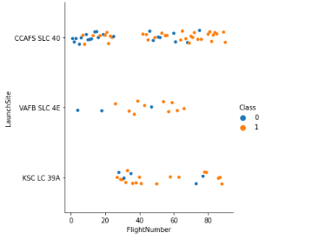
Flight Number vs. Launch Site
We can see that most of bad landing are on the first flight . Experience increase the success.
We also can see than we have more bad landing on CCAFS SLC 40 regardless of the experience effect.

Slide 23
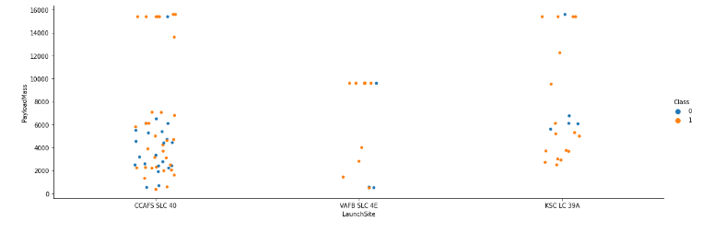
Payload vs. Launch Site
The VAFB-SLC launchsite there are no rockets launched for heavypayload mass(greater than 10000).
CCAFS SLC 40 is the most used launch site. He ‘s more efficient on the launch of heavy payload.

Slide 24
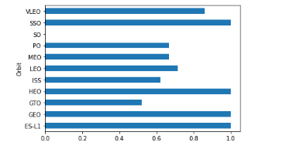
Success Rate vs. Orbit Type
Four orbites have 100% of success (SSO,HEO,GEO,ES-L1)
One orbite have more than 80% of success (VLEO)
Four orbite have arround 60% of success (PO,MEO,LEO,ISS)
GTO have approximatly 50% of succes.
SO have no succes
We have to be careful with the chart because we don’t look at the number of attempt per orbite at that point.

Slide 25
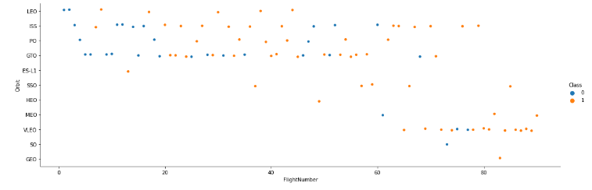
Flight Number vs. Orbit Type
In the LEO orbit the Success appears related to the number of flights; on the other hand, there seems to be no relationship between flight number when in GTO orbit.
SO and GEO had only on attempt.

Slide 26
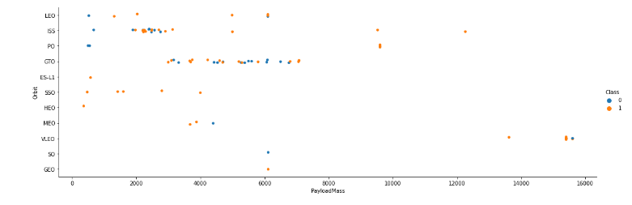
Payload vs. Orbit Type
With heavy payloads the successful landing or positive landing rate are more for Polar,LEO and ISS.
However for GTO we cannot distinguish this well as both positive landing rate and negative landing(unsuccessful mission) are both there here.

Slide 27
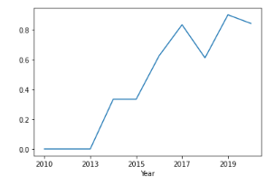
Launch Success Yearly Trend
We can observe that the sucess rate since 2013 kept increasing till 2020

Slide 28
All Launch Site Names
The unique launch site are:
CCAFS SLC 40
VAFB SLC 4E
KSC LC 39A
Using the DF.unique() method we saw that we have 3 launch site.

Slide 29
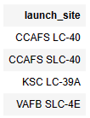
All Launch Site Names
We have 4 launch site used.

Slide 30
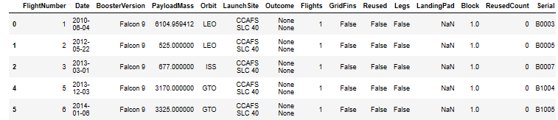
Launch Site Names Begin with 'CCA'
To find records with launch site which begins with “CCA” I use the code below. The result is the 5 first records which meet the requirement.
df[df.LaunchSite.str.startswith('CCA')].head()

Slide 31
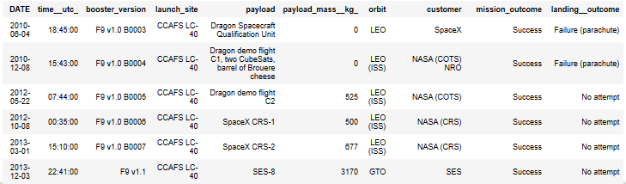
Launch Site Names Begin with 'CCA'

Slide 32
Total Payload Mass
The total payload carry by boosters launched by NASA (CRS) is 20.
It seems that NASA launched 20 tons of materials.

Slide 33
Average Payload Mass by F9 v1.1
The average payload mass carried by booster version F9 v1.1 is 2928 kgs.
We must not confuse with median weight.

Slide 34
First Successful Ground Landing Date
The first successful landing outcome on ground pad became the 2015-12-22

Slide 35
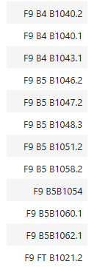
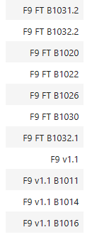
Successful Drone Ship Landing with Payload between 4000 and 6000
the names of boosters which have successfully landed on drone ship and had payload mass greater than 4000 but less than 6000

Slide 36
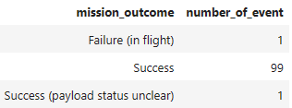
Total Number of Successful and Failure Mission Outcomes
The total number of successful and failure mission outcomes

Slide 37
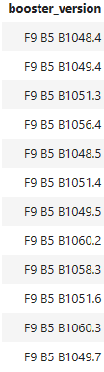
Boosters Carried Maximum Payload
The names of the booster which have carried the maximum payload mass

Slide 38
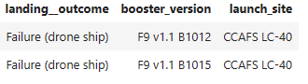
2015 Launch Records
the failed landing_outcomes in drone ship, their booster versions, and launch site names for in year 2015

Slide 39
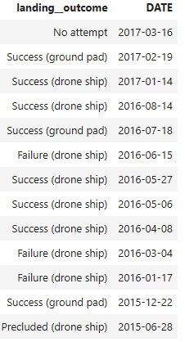
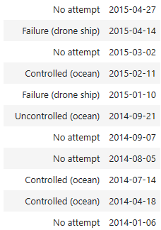
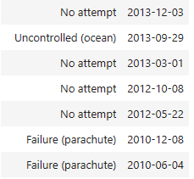
Rank Landing Outcomes Between 2010-06-04 and 2017-03-20
The count of landing outcomes (such as Failure (drone ship) or Success (ground pad)) between the date 2010-06-04 and 2017-03-20, in descending order

Slide 40

Section 3

Slide 41
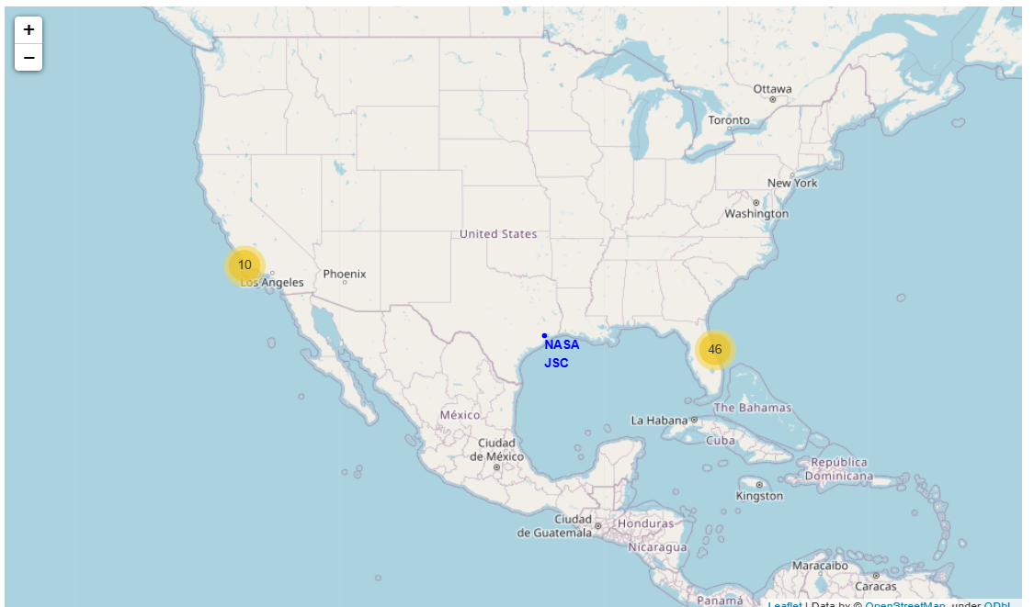
Launch Site localization
We can see launch sites are on the two costs of USA.
The east site launch almost 5 times more engine than the west one.

Slide 42
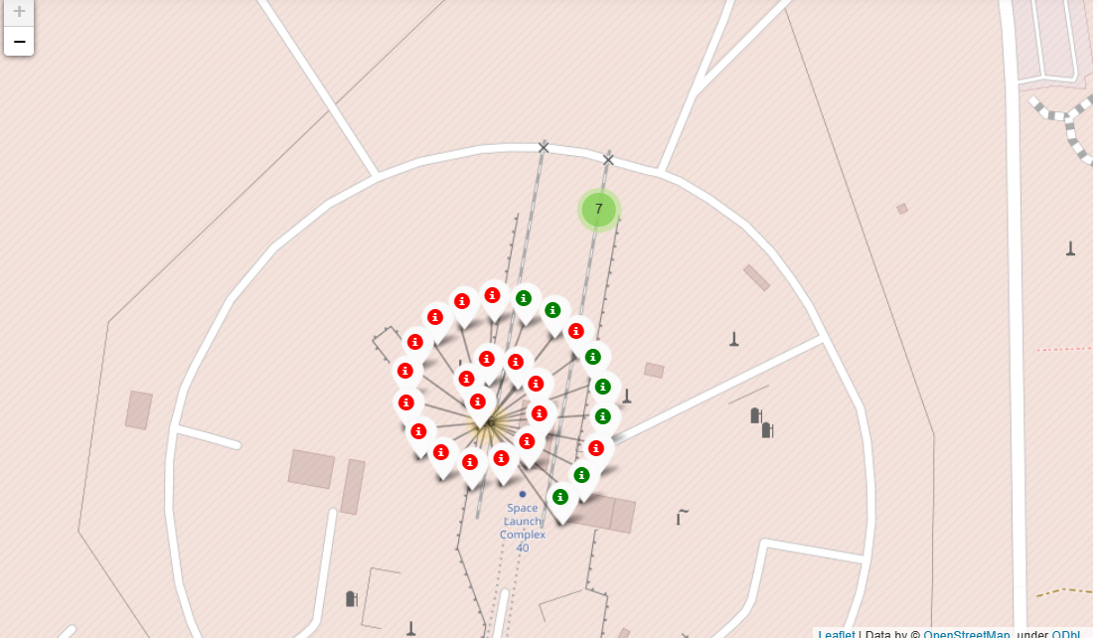
Outcome visualization per site
This map show us that only 7 launch success for 26 attempts.
We can focus on this details for each site.

Slide 43
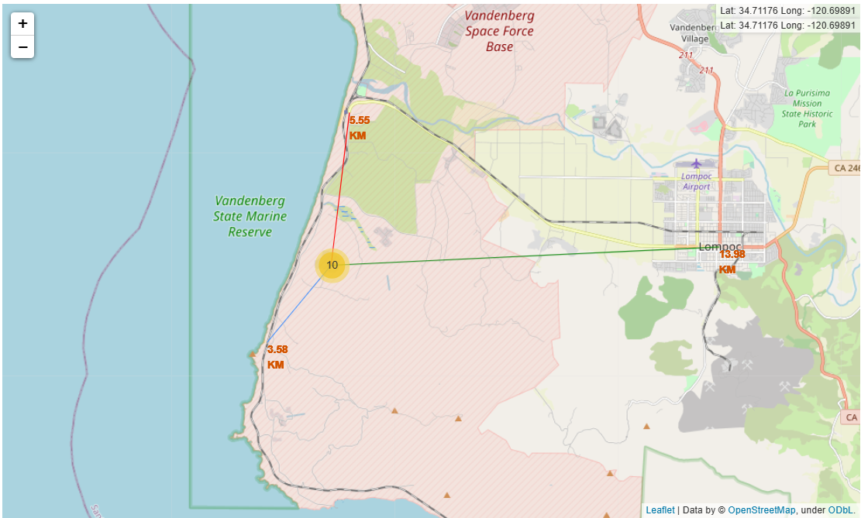
Facilities locations
We can see geographic location with all the facilities for each site.
This visualization is very useful for logistic issues.

Slide 44

Section 4

Slide 45
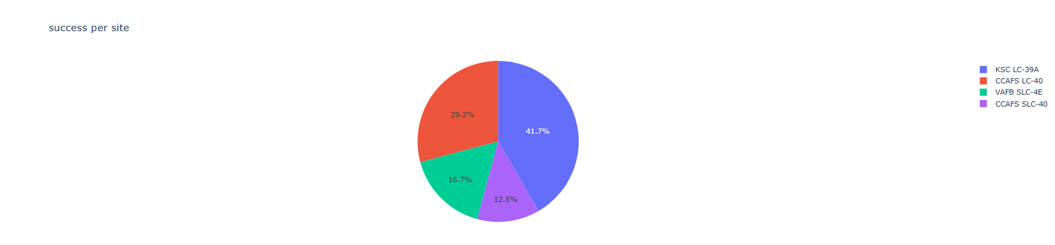
Distribution by site of successful launches
Almost half of the success launch has been made from KSC LC-39A.
A third of the success launch has been made from CCAFS LC-40

Slide 46
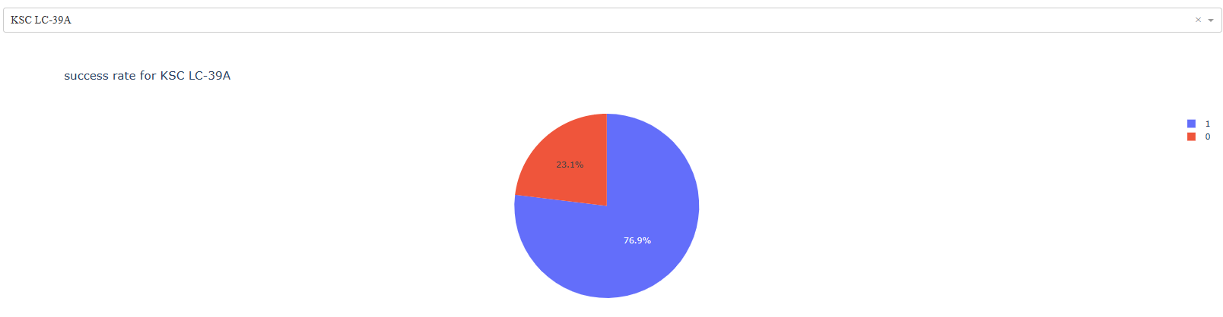
KSC LC-39A: launch outcome distribution.
76,9% of the launch has succeeded

Slide 47
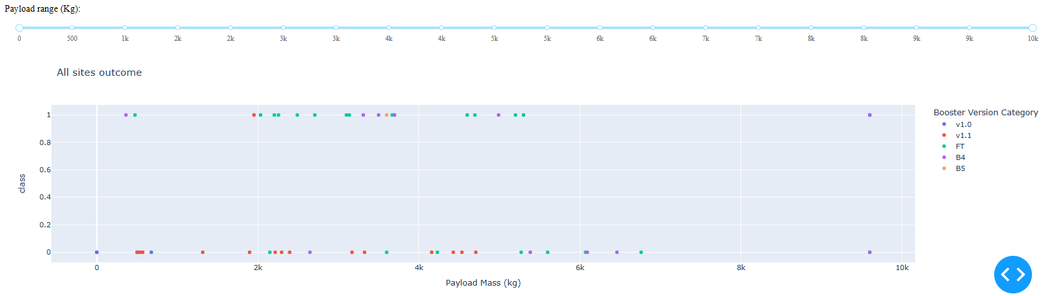
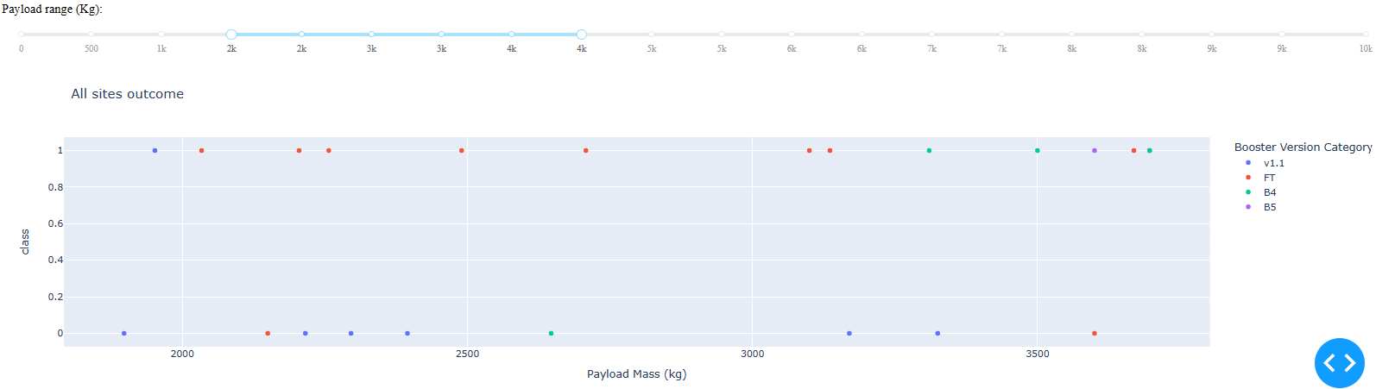
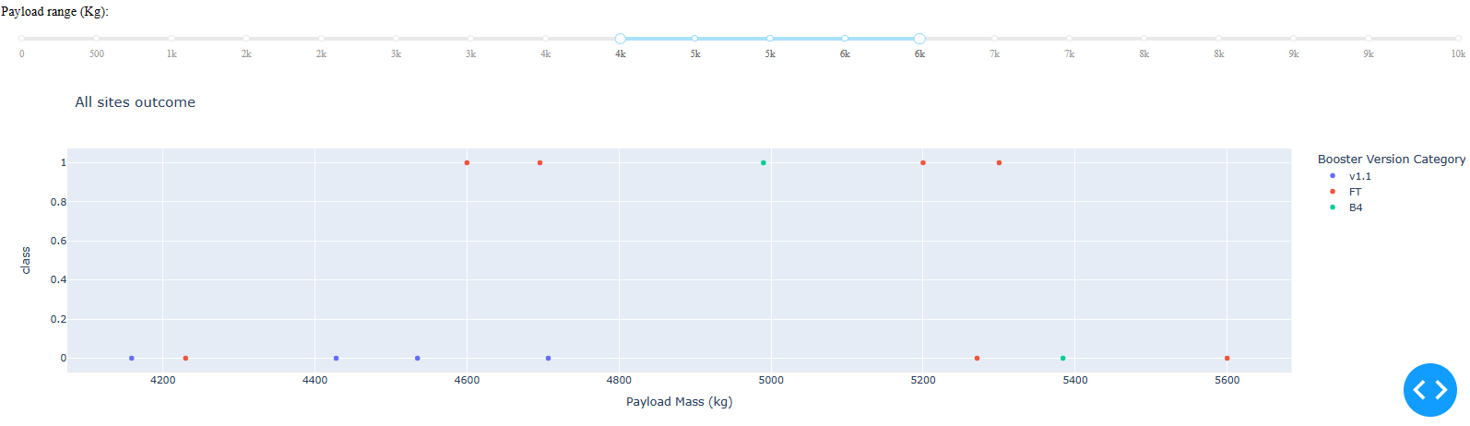
Launch outcome by Payload Mass.
The first graph show us that most of the launch has been made for a payload between 2000k and 6000k. We can also see that FT booster is the most efficient.
The two other graph focuses on Payload (2000k increment). We can see that booster version V1.1 is not efficient.

Slide 48

Section 5

Slide 49
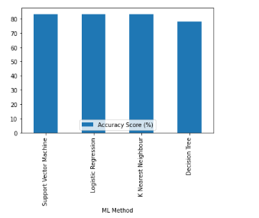
Classification Accuracy
SVM, Logisitic Regression and K Nearest Neighbours have the same accuracy on test data set.
The score is 83,33%

Slide 50
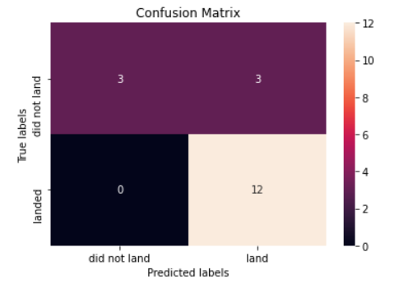
Confusion Matrix
Our model predict good result for 100% of the real landed mission.
Our model predict good result for 50% of the real crashed missions.

Slide 51
Conclusions
Experience has an important impact on result.
Results are better for smaller payload
Orbite have an impact on result
Booster version have a very important impact on result
Predicitve models give us a good result at 83%.

Slide 52


